Slide 1
Database Systems
Chapter # 7
More SQL: Complex Queries, Triggers, Views, and Schema Modification

Slide 2
Chapter Outlines
More Complex SQL Retrieval Queries
Views (Virtual Tables) in SQL
Schema Change Statements in SQL

Slide 3
Joined Tables in SQL and Outer Joins
SQL joins are used to combine two or more tables.
The joining of two or more tables is based on common field between them.
Syntax:
select col1,col2,....
from table1 JOIN table2 ON (common columns in both tables)
where condition

Slide 4
Types of Joins
Cartesian Product
Equi JOIN/ Inner Join/ Join
Left outer Join/ Left Join
Right Outer Join/ Right Join
Self Join

Slide 5
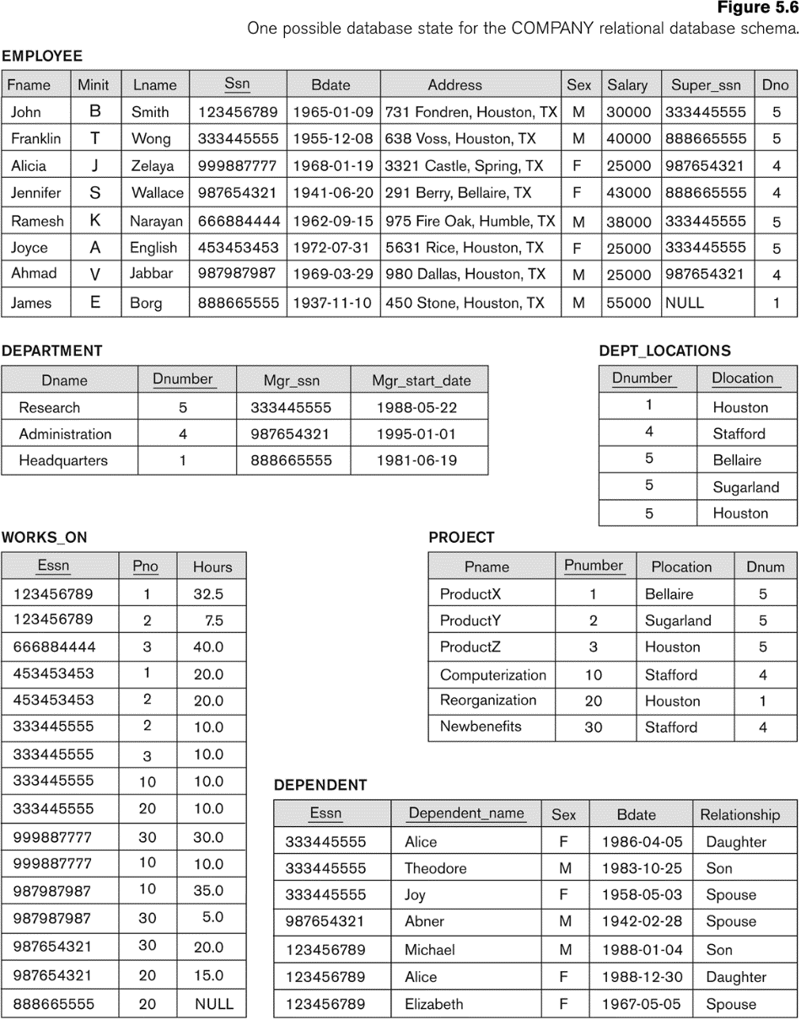
Basic SQL Queries: The SELECT-FROM-WHERE Structure with join
Query 1. Retrieve the name and address of all employees who work for the
‘Research’ department.
Notes:
SELECT Fname, Lname, Address FROM EMPLOYEE, DEPARTMENT WHERE Dname = ‘Research’ AND Dnumber = Dno;
In the WHERE clause of Q1, the condition Dname = ‘Research’ is a selection condition that chooses the particular tuple of interest in the DEPARTMENT table, because Dname is an attribute of DEPARTMENT. The condition Dnumber = Dno is called a join condition, because it combines two tuples: one from DEPARTMENT and one from EMPLOYEE, whenever the value of Dnumber in DEPARTMENT is equal to the value of Dno in EMPLOYEE. The result of query Q1 is shown in Figure 6.3(b). In general, any number of selection and join conditions may be specified in a single SQL query. A query that involves only selection and join conditions plus projection attributes is known as a select-project-join query. The next example is a select-project-join query with two join conditions

Slide 6
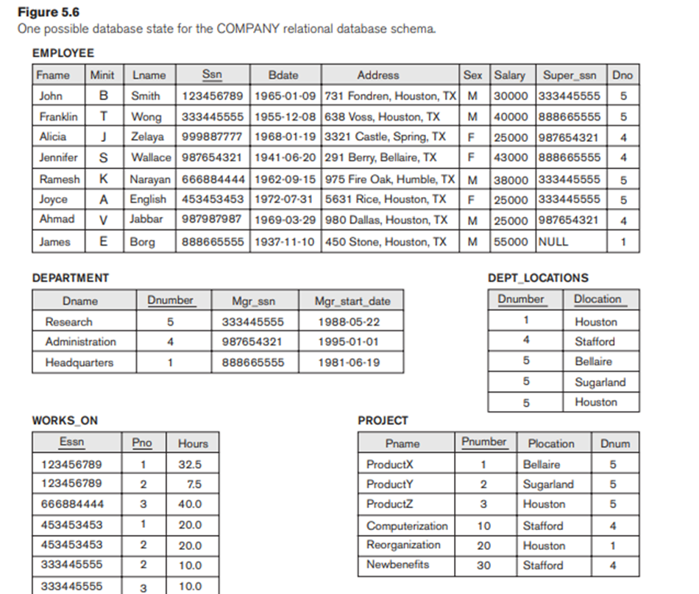

Example
Retrieves the name and address of every employee who works for the ‘Research’ department.
Notes:
The FROM clause in Q1A contains a single joined table.
The attributes of such a table are all the attributes of the first table, EMPLOYEE, followed by all the attributes of the second table, DEPARTMENT.
The concept of a joined table also allows the user to specify different types of join, such as NATURAL JOIN and various types of OUTER JOIN.

Slide 7
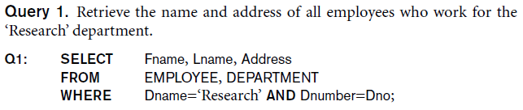
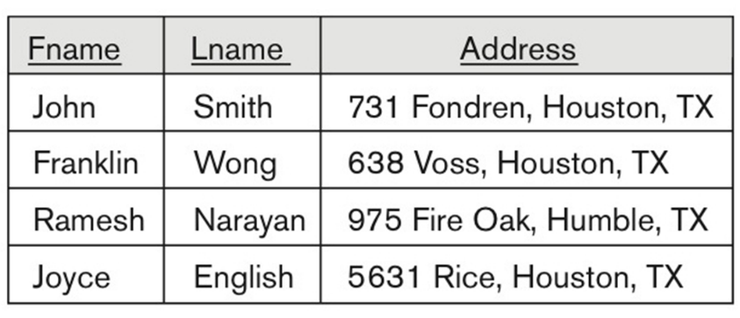
Basic SQL Queries: The SELECT-FROM-WHERE Structure with join
Notes:
SELECT Fname, Lname, Address FROM EMPLOYEE, DEPARTMENT WHERE Dname = ‘Research’ AND Dnumber = Dno;

Slide 8
Basic SQL Queries: The SELECT-FROM-WHERE Structure with join
Query 2. For every project located in ‘Stafford’, list the project number, the
controlling department number, and the department manager’s last name,
address, and birth date.
Notes:
SELECT Pnumber, Dnum, Lname, Address, Bdate FROM PROJECT, DEPARTMENT, EMPLOYEE WHERE Dnum = Dnumber AND Mgr_ssn = Ssn AND Plocation = ‘Stafford’
In the WHERE clause of Q1, the condition Dname = ‘Research’ is a selection condition that chooses the particular tuple of interest in the DEPARTMENT table, because Dname is an attribute of DEPARTMENT. The condition Dnumber = Dno is called a join condition, because it combines two tuples: one from DEPARTMENT and one from EMPLOYEE, whenever the value of Dnumber in DEPARTMENT is equal to the value of Dno in EMPLOYEE. The result of query Q1 is shown in Figure 6.3(b). In general, any number of selection and join conditions may be specified in a single SQL query. A query that involves only selection and join conditions plus projection attributes is known as a select-project-join query. The next example is a select-project-join query with two join conditions

Slide 9
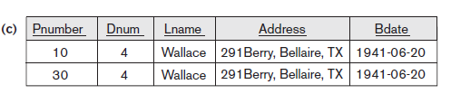
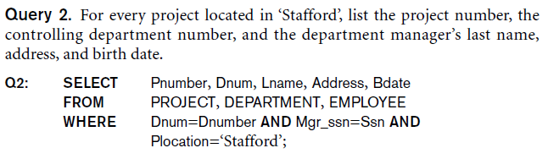
Basic SQL Queries: The SELECT-FROM-WHERE Structure with join
Notes:
SELECT Pnumber, Dnum, Lname, Address, Bdate FROM PROJECT, DEPARTMENT, EMPLOYEE WHERE Dnum = Dnumber AND Mgr_ssn = Ssn AND Plocation = ‘Stafford’

Slide 10
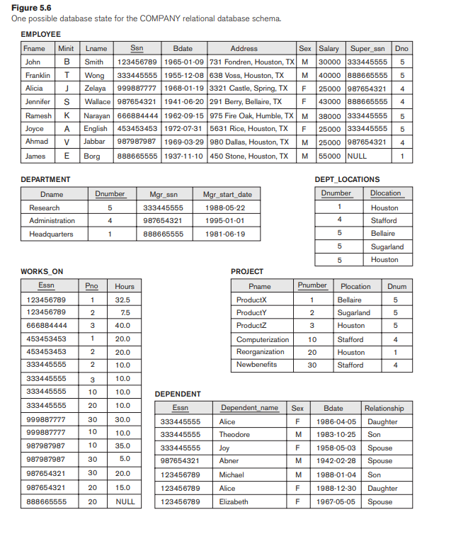
Query 2. For every project located in ‘Stafford’, list the project number, the controlling department number, and the department manager’s last name, address, and birth date
Notes:
Q2A: SELECT Pnumber, Dnum, Lname, Address, Bdate
FROM ((PROJECT JOIN DEPARTMENT ON Dnum = Dnumber)
JOIN EMPLOYEE ON Mgr_ssn = Ssn)
WHERE Plocation = ‘Stafford’;

Slide 11
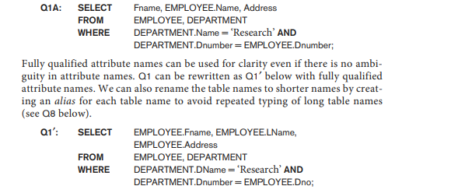
Ambiguous Attribute Names, Aliasing, Renaming, and Tuple Variables
Same name can be used for two (or more) attributes in different relations
As long as the attributes are in different relations
Must qualify the attribute name with the relation's name to prevent ambiguity
Notes:
In SQL, the same name can be used for two (or more) attributes as long as the attributes are in different tables. If this is the case, and a multitable query refers to two or more attributes with the same name, we must qualify the attribute name with the relation name to prevent ambiguity. This is done by prefixing the relation name to the attribute name and separating the two by a period. To illustrate this, suppose that in Figures 5.5 and 5.6 the Dno and Lname attributes of the EMPLOYEE relation were called Dnumber and Name, and the Dname attribute of DEPARTMENT was also called Name; then, to prevent ambiguity, query Q1 would be rephrased as shown in Q1A. We must prefix the attributes Name and Dnumber in Q1A to specify which ones we are referring to, because the same attribute names are used in both relations:

Slide 12
SELF JOIN
Query 3. For each employee, retrieve the employee’s first and last name and the first and last name of his or her immediate supervisor.
Notes:
SELECT E.Fname, E.Lname, S.Fname, S.Lname FROM EMPLOYEE AS E, EMPLOYEE AS S WHERE E.Super_ssn = S.Ssn;

Slide 13
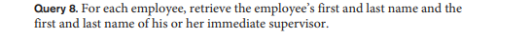
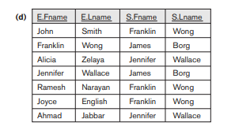
SELECT E.Fname, E.Lname, S.Fname, S.Lname FROM EMPLOYEE E, EMPLOYEE S WHERE E.Super_ssn = S.Ssn;
Notes:
SELECT E.Fname, E.Lname, S.Fname, S.Lname FROM EMPLOYEE AS E, EMPLOYEE AS S WHERE E.Super_ssn = S.Ssn;

Slide 14

ORDER BY
Query 15. Retrieve a list of employees and the projects they are working on,
ordered by department name and, within each department, ordered alphabetically by
last name, then first name.
SELECT D.Dname, E.Lname, E.Fname, P.Pname
FROM DEPARTMENT D, EMPLOYEE E, WORKS_ON W, PROJECT P
WHERE D.Dnumber = E.Dno AND E.Ssn = W.Essn AND W.Pno = P.Pnumber
ORDER BY D.Dname, E.Lname, E.Fname;
ORDER BY D.Dname DESC, E.Lname ASC, E.Fname ASC
Notes:
Q15: SELECT D.Dname, E.Lname, E.Fname, P.Pname
FROM DEPARTMENT D, EMPLOYEE E, WORKS_ON W,
PROJECT P
WHERE D.Dnumber = E.Dno AND E.Ssn = W.Essn AND W.Pno = P.Pnumber
ORDER BY D.Dname, E.Lname, E.Fname;

Slide 15
NATURAL JOIN
In a NATURAL JOIN on two relations R and S, no join condition is specified;
An implicit EQUIJOIN condition for each pair of attributes with the same name from R and S is created.
Each such pair of attributes is included only once in the resulting relation.
Q1B: SELECT Fname, Lname, Address, D.Dnumber AS Dno
FROM (EMPLOYEE E NATURAL JOIN DEPARTMENT D
WHERE Dname = ‘Research’;
Implicit join condition: EMPLOYEE.Dno = DEPT.Dno
Notes:
In a NATURAL JOIN on two relations R and S, no join condition is specified; an implicit EQUIJOIN condition for each pair of attributes with the same name from R and S is created. Each such pair of attributes is included only once in the resulting
Relation.
Very Important
If the names of the join attributes are not the same in the base relations, it is possible to rename the attributes so that they match, and then to apply NATURAL JOIN. In this case, the AS construct can be used to rename a relation and all its attributes in the FROM clause.
This is illustrated in Q1B, where the DEPARTMENT relation is renamed as DEPT and its attributes are renamed as Dname, Dno (to match the name of the desired join attribute Dno in the EMPLOYEE table), Mssn, and Msdate. The implied join condition for this NATURAL JOIN is EMPLOYEE.Dno = DEPT.Dno, because this is the only pair of attributes with the same name after renaming:

Slide 16
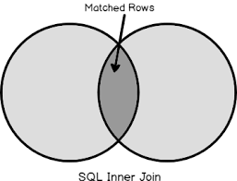
Inner join/Join
Default type of join in a joined table
Tuple is included in the result only if a matching tuple exists in the other relation.
Notes:
In SQL, the options available for specifying joined tables include INNER JOIN (only pairs of tuples that match the join condition are retrieved, same as JOIN)
LEFT OUTER JOIN (every tuple in the left table must appear in the result; if it does not have a matching tuple, it is padded with NULL values for the attributes of the right table),
RIGHT OUTER JOIN (every tuple in the right table must appear in the result; if it does not have a matching tuple, it is padded with NULL values for the attributes of the left table), and
FULL OUTER JOIN.
In the latter three options, the keyword OUTER may be omitted.
If the join attributes have the same name, one can also specify the natural join variation of outer joins by using the keyword NATURAL before the operation (for example, NATURAL LEFT OUTER JOIN). The keyword CROSS JOIN is used to specify
the CARTESIAN PRODUCT operation, although this should be used only with the utmost care because it generates all possible tuple combinations.
It is also possible to nest join specifications; that is, one of the tables in a join may itself be a joined table. This allows the specification of the join of three or more tables as a single joined table, which is called a multiway join. For example,
Q2A is a different way of specifying query Q2 from Section 6.3.1 using the concept of a joined table:
Q2A: SELECT Pnumber, Dnum, Lname, Address, Bdate
FROM ((PROJECT JOIN DEPARTMENT ON Dnum = Dnumber)
JOIN EMPLOYEE ON Mgr_ssn = Ssn)
WHERE Plocation = ‘Stafford’;

Slide 17
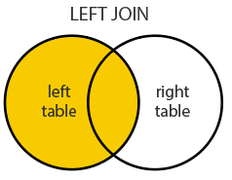
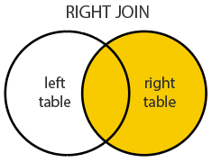
Outer JOIN
LEFT OUTER JOIN
Every tuple in left table must appear in result
No matching tuple: attributes of right table are Padded with NULL values
RIGHT OUTER JOIN
Every tuple in right table must appear in result
No matching tuple: attributes of left table are Padded with NULL values

Slide 18

Query 8. For each employee, retrieve the employee’s first and last name and the first and last name of his or her immediate supervisor.

Slide 19

Comparison Operator: IS or IS NOT
IS or IS NOT: check whether an attribute value is NULL or NOT NULL

Slide 20
Nested Queries/ Subqueries
Subqueries:
can be placed in a number of SQL clauses like
WHERE clause
FROM clause
HAVING clause.
can be used with SELECT, UPDATE, INSERT, DELETE statements along with the operators like =, <, >, >=, <=, IN, BETWEEN, etc.
A subquery is a query within another query. The outer query is known as the main query, and the inner query is known as a subquery.
Subqueries are on the right side of the comparison operator and enclosed in parentheses.

Slide 21
Sub Queries: Syntax
SELECT column_name
FROM table_name
WHERE column_name expression operator
( SELECT column_name from table_name WHERE ... );
Notes:
Some queries require that existing values in the database be fetched and then used in a comparison condition. Such queries can be conveniently formulated by using nested queries, which are complete select-from-where blocks within another SQL query. That other query is called the outer query. These nested queries can also appear in the WHERE clause or the FROM clause or the SELECT clause or other SQL clauses as needed.
Query 4 is formulated in Q4 without a nested query, but it
can be rephrased to use nested queries as shown in Q4A. Q4A introduces the comparison
operator IN, which compares a value v with a set (or multiset) of values V
and evaluates to TRUE if v is one of the elements in V.

Slide 22
Demo Database: Employee Table
ID | NAME | AGE | ADDRESS | SALARY
1 | John | 20 | US | 2000.00
2 | Stephan | 26 | Dubai | 1500.00
3 | David | 27 | Bangkok | 2000.00
4 | Alina | 29 | UK | 6500.00
5 | Kathrin | 34 | Bangalore | 8500.00
6 | Harry | 42 | China | 4500.00
7 | Jackson | 25 | Mizoram | 10000.00
Display the name of the employee who is getting max salary.
select name from employees where salary = (select max(Salary)from employees);

Slide 23
Equal to and In
If a nested query returns a single attribute and a single tuple: use = instead of IN for the comparison operator.
In general, the nested query may return a table (relation), which is a set or multiset of tuples.

Slide 24
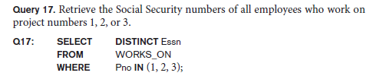

Explicit Sets and Renaming in SQL
Explicit set of values in the WHERE clause using IN Operator.
AS construct: used to alias both attribute and relation names

Slide 25
Display NAME, LOCATION, PHONE_NUMBER of the students whose section is A.
Students Relation
Section Relation
NAME | ROLL_NO | LOCATION | PHONE_NUMBER
Ram | 101 | Chennai | 9988775566
Raj | 102 | Coimbatore | 8877665544
Sasi | 103 | Madurai | 7766553344
Ravi | 104 | Salem | 8989898989
Sumathi | 105 | Kanchipuram | 8989856868
NAME | ROLL_NO | SECTION
Ravi | 104 | A
Sumathi | 105 | B
Raj | 102 | A
Select
NAME, LOCATION, PHONE_NUMBER from Students
WHERE ROLL_NO IN
(SELECT ROLL_NO from SECTION where SECTION=’A’);
Notes:
Select NAME, LOCATION, PHONE_NUMBER from Students
WHERE ROLL_NO IN
(SELECT ROLL_NO from SECTION where SECTION=’A’);

Slide 26
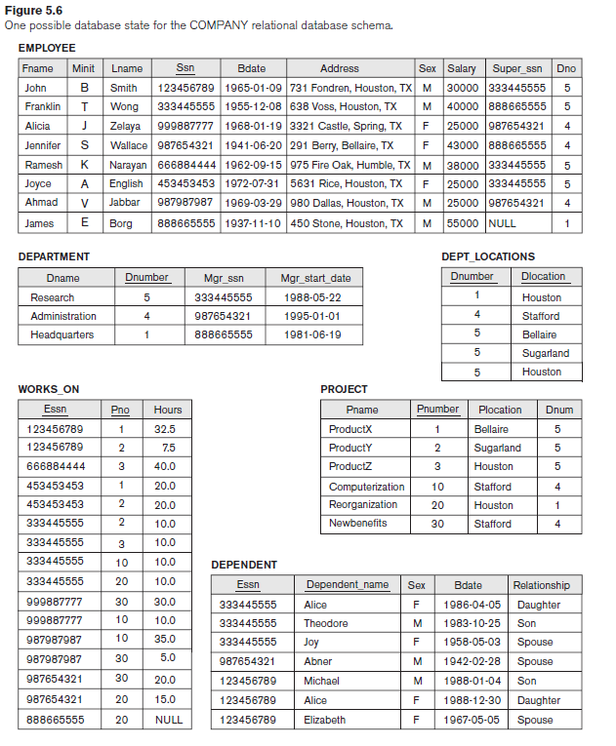
Select the Essns of all employees who work the same (project, hours) combination on some project that employee ‘John Smith’ (whose Ssn = ‘123456789’)
SELECT DISTINCT Essn FROM WORKS_ON WHERE (Pno, Hours) IN ( SELECT Pno, Hours FROM WORKS_ON WHERE Essn = ‘123456789’ );

Slide 27
ALL
ALL: used to compare a value to a list or subquery. It must be preceded by =, !=, >, <, <=, >= and followed by a list or subquery.
"x = ALL (...)": The value must match all the values in the list to evaluate to TRUE.
"x != ALL (...)": The value must not match any values in the list to evaluate to TRUE.
"x > ALL (...)": The value must be greater than the biggest value in the list to evaluate to TRUE.
"x < ALL (...)": The value must be smaller than the smallest value in the list to evaluate to TRUE.
"x >= ALL (...)": The value must be greater than or equal to the biggest value in the list to evaluate to TRUE.
"x <= ALL (...)": The value must be smaller than or equal to the smallest value in the list to evaluate to TRUE.

Slide 28
Exercise:
Write a query that returns the names of employees whose salary is greater than the salary of all the employees in department 5
Notes:
SELECT Lname, Fname
FROM EMPLOYEE
WHERE Salary > ALL ( SELECT Salary
FROM EMPLOYEE
WHERE Dno = 5 );

Slide 29
Make a list of all project numbers for projects that involve an employee whose last name is ‘Smith’, either as a worker or as a manager of the department that controls the project.
Notes:
SELECT DISTINCT Pnumber FROM PROJECT WHERE Pnumber IN ( SELECT Pnumber FROM PROJECT, DEPARTMENT, EMPLOYEE WHERE Dnum = Dnumber AND Mgr_ssn = Ssn AND Lname = ‘Smith’ ) OR Pnumber IN ( SELECT Pno FROM WORKS_ON, EMPLOYEE WHERE Essn = Ssn AND Lname = ‘Smith’ );

Slide 30
SELECT DISTINCT Pnumber
FROM PROJECT WHERE Pnumber IN
( SELECT Pnumber FROM PROJECT, DEPARTMENT, EMPLOYEE WHERE Dnum = Dnumber AND Mgr_ssn = Ssn AND Lname = ‘Smith’ )
OR Pnumber IN
( SELECT Pno FROM WORKS_ON, EMPLOYEE WHERE Essn = Ssn AND Lname = ‘Smith’ );

Slide 31
ANY
The ANY comparison condition is used to compare a value to a list or subquery. It must be preceded by =, !=, >, <, <=, >= and followed by a list or subquery.
"x = ANY (...)": The value must match one or more values in the list to evaluate to TRUE.
"x != ANY (...)": The value must not match one or more values in the list to evaluate to TRUE.
"x > ANY (...)": The value must be greater than the smallest value in the list to evaluate to TRUE.
"x < ANY (...)": The value must be smaller than the biggest value in the list to evaluate to TRUE.
"x >= ANY (...)": The value must be greater than or equal to the smallest value in the list to evaluate to TRUE.
"x <= ANY (...)": The value must be smaller than or equal to the biggest value in the list to evaluate to TRUE.

Slide 32
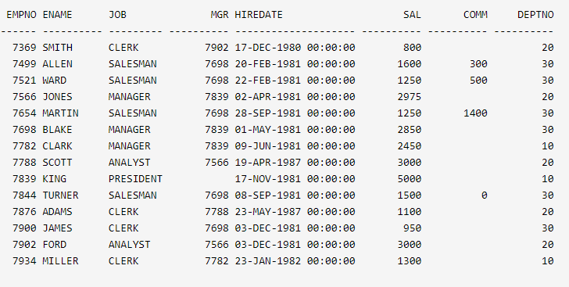
SELECT empno, sal
FROM emp
WHERE
sal > ANY (2000, 3000, 4000);
EMPNO SAL
7566 2975
7698 2850
7782 2450
7788 3000
7839 5000
7902 3000

Slide 33
Type of Subqueries
Single row subquery : Returns zero or one row. Uses Aggregate functions (max, min, avg, count,sum)
Multiple row subquery : Returns one or more rows.
Multiple column subqueries : Returns one or more columns.
Correlated subqueries : Reference one or more columns in the outer SQL statement. The subquery is known as a correlated subquery because the subquery is related to the outer SQL statement.

Slide 34
Correlated Nested Queries
Whenever a condition in the WHERE clause of a nested query references some attribute of a relation declared in the outer query, the two queries are said to be correlated.
Evaluated as a top-down approach

Slide 35
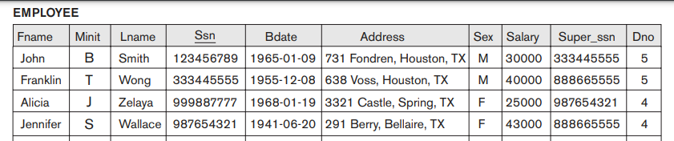
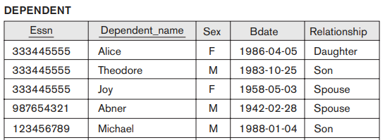
Retrieve the name of each employee who has a dependent with the same first name and is the same sex as the employee.
SELECT E.Fname, E.Lname FROM EMPLOYEE AS E
WHERE E.Ssn IN
(SELECT D.Essn FROM DEPENDENT AS D
WHERE E.Fname = D.Dependent_name AND E.Sex = D.Sex );
Notes:
For each EMPLOYEE tuple, evaluate the nested query, which retrieves the Essn values for all DEPENDENT tuples with the same sex and name as that EMPLOYEE tuple; if the Ssn value of the EMPLOYEE tuple is in the result of the nested query, then select that EMPLOYEE tuple.
Another way of writing same query
SELECT E.Fname, E.Lname
FROM EMPLOYEE AS E, DEPENDENT AS D
WHERE E.Ssn = D.Essn AND E.Sex = D.Sex
AND E.Fname = D.Dependent_name;

Slide 36
Exists and Not Exists
The EXISTS function: used to check whether the result of a nested query is empty (contains no tuples) or not.
The result of EXISTS is a Boolean value TRUE if the nested query result contains at least one tuple, or FALSE if the nested query result contains no tuples.

Slide 37
Retrieve the names of employees who have no dependents.
SELECT Fname, Lname FROM EMPLOYEE WHERE NOT EXISTS ( SELECT * FROM DEPENDENT D WHERE E.Ssn = D.Essn );

Slide 38
Retrieve the name of each employee who has a dependent with the same first name and is the same sex as the employee.
SELECT E.Fname, E.Lname FROM EMPLOYEE E WHERE EXISTS
( SELECT * FROM DEPENDENT D WHERE E.Ssn = D.Essn AND E.Sex = D.Sex AND E.Fname = D.Dependent_name);

Slide 39
List the names of managers of department who have at least one dependent.
Notes:
SELECT Fname, Lname FROM EMPLOYEE WHERE EXISTS ( SELECT * FROM DEPENDENT WHERE Ssn = Essn ) AND EXISTS ( SELECT * FROM DEPARTMENT WHERE Ssn = Mgr_ssn );

Slide 40
Retrieve the names of all employees who have two or more dependents
Notes:
SELECT Lname, Fname
FROM EMPLOYEE
WHERE ( SELECT COUNT (*)
FROM DEPENDENT
WHERE Ssn = Essn ) > = 2;
The correlated nested query counts the number of dependents that each employee
has; if this is greater than or equal to two, the employee tuple is selected.

Slide 41
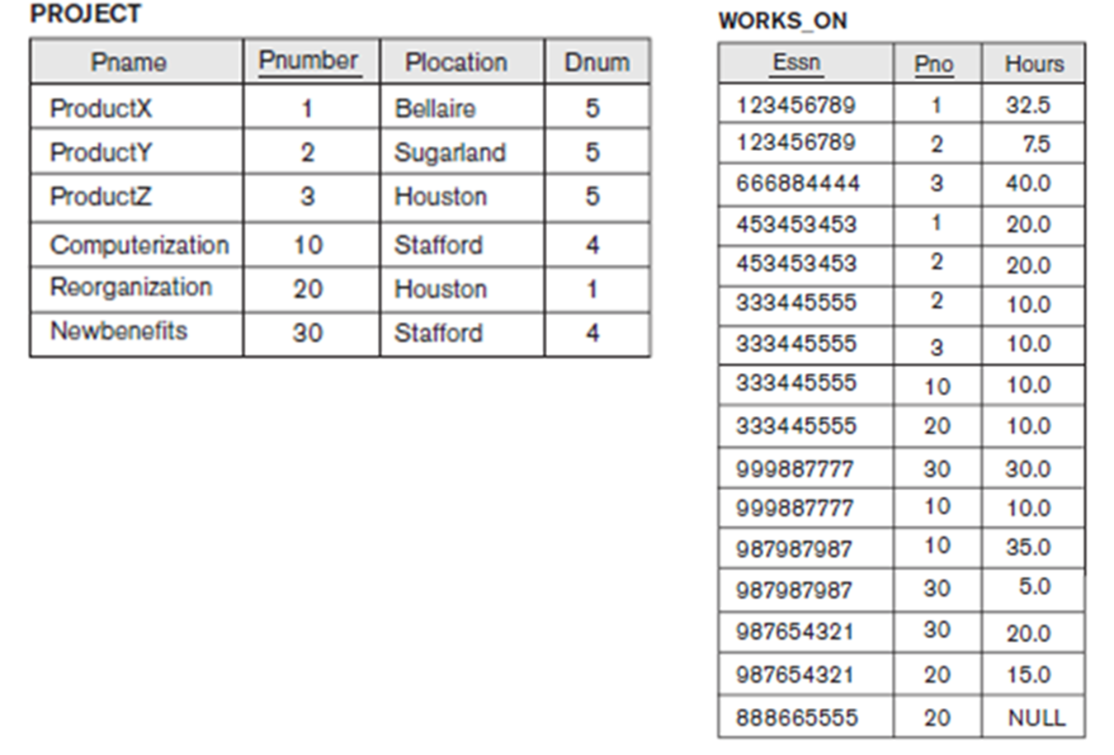
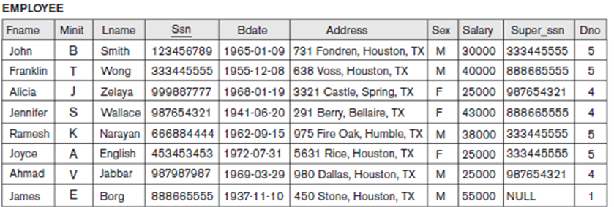
For each project, retrieve the project number, the project name, and the number of employees from department 5 who work on the project.
SELECT Pnumber, Pname, COUNT (*)
FROM PROJECT, WORKS_ON, EMPLOYEE
WHERE Pnumber = Pno AND Ssn = Essn AND Dno = 5
GROUP BY Pnumber, Pname;
Notes:
Q27: SELECT Pnumber, Pname, COUNT (*)
FROM PROJECT, WORKS_ON, EMPLOYEE
WHERE Pnumber = Pno AND Ssn = Essn AND Dno = 5
GROUP BY Pnumber, Pname;

Slide 42
Schema Change Statements in SQL
DROP TABLE table_name;
SQL TRUNCATE TABLE: used to delete the data inside a table, but not the table itself.
TRUNCATE TABLE table_name;
Notes:
In this section, we give an overview of the schema evolution commands available in SQL, which can be used to alter a schema by adding or dropping tables, attributes, constraints, and other schema elements. This can be done while the database is operational and does not require recompilation of the database schema. Certain checks must be done by the DBMS to ensure that the changes do not affect the rest of the database and make it inconsistent

Slide 43
SQL ALTER TABLE Statement
ADD COLUMNS
ALTER TABLE table_name
ADD column_name datatype;
ALTER TABLE table_name
MODIFY column_name datatype;

Slide 44
DROP COLUMNS AND CONSTRAINTS
Drop Column
ALTER TABLE table_name
DROP COLUMN column_name;
Drop constraints
ALTER TABLE table_name
DROP CONSTRAINT Constraint_name;

Slide 45
Add constraints
Unique Constraint
ALTER TABLE table_name
ADD CONSTRAINT constraint_name UNIQUE(column1, column2...);
Check Constraint
ALTER TABLE table_name
ADD CONSTRAINT constraint_name CHECK (CONDITION);
Primary Key
ALTER TABLE table_name
ADD CONSTRAINT constraint_name Primary Key (COL1,COL2,…);
Notes:
Not null constraint must be specified when the column is altered that’s why it is not mentioned over the slide.

Slide 46
Add constraints
FOREIGN KEY Key
ALTER TABLE table_name
ADD CONSTRAINT constraint_name FOREIGN KEY (COLUMN_NAME) REFFERENCES TABLE_NAME (COL1);

